Slide 1
Damaged Beam & Loose Beam End Management
Mike Benzy / Claims Prevention
03/01/2017

Slide 2
Executive Summary
What is the opportunity for the QAT?
The current process for managing and shipping damaged beams and loose beam ends to beam repair locations produces too much waste from lost time and unused resources
What data was used to determine the root cause?
Dock observations at multiple locations, decking management report, company bills originating from the NAS center containing damaged beams.
What is the root cause of the issue?
Damaged beams are mixed with good beams in dock decking carts and in various piles around the dock. The loose beam ends are scattered around the dock and eventually thrown away. There is no process at NAS or in the system to collect and bundle damaged beams & ends consistently.
What solution was developed and implemented?
Beam stacking & bundling rack process
After at least 90 days of measurable results, how do the measured results compare to the QATs goal and/or former process?
A consistent process was developed & implemented in NAS, which led to system-wide change

Slide 3
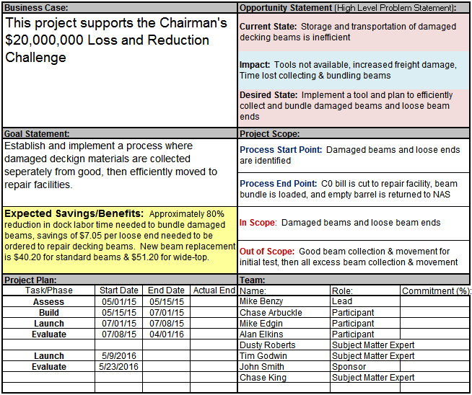
Assess – Project Charter

Slide 4
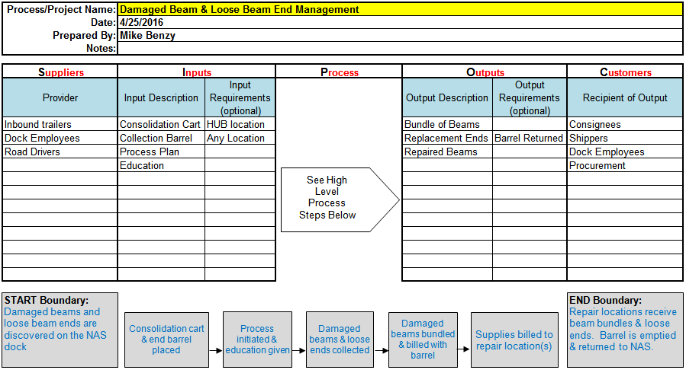
Assess - SIPOC

Slide 5
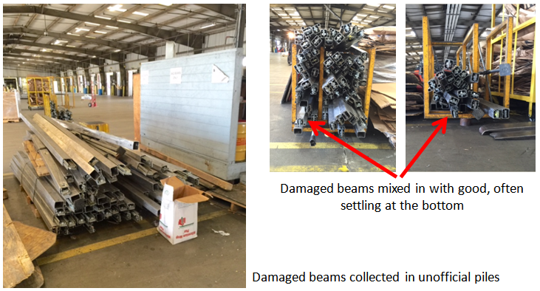
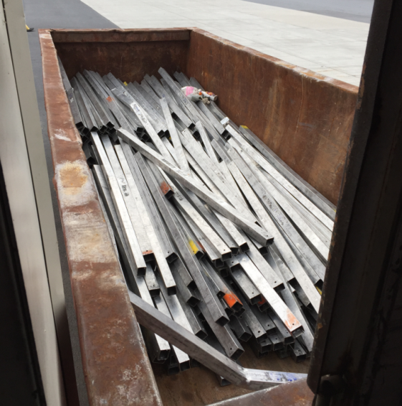
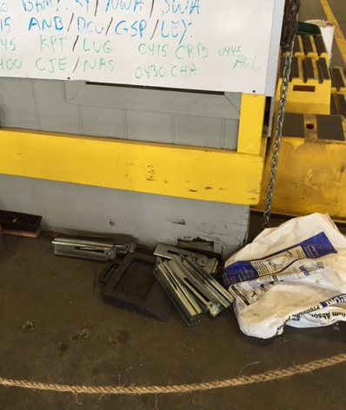
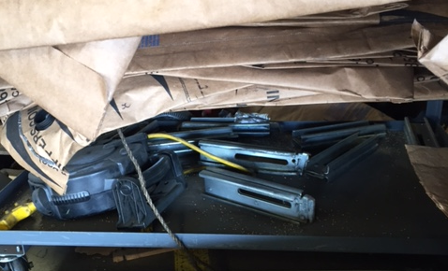
Assess – Current Condition / Storage & Movement
Damaged beams and ends that are recycled or thrown away rather than repaired return approx. $0.10 per pound scrap.
Standard decking beams are $40.20 each, wide-tops are $51.20 per new beam. Replacement ends are $7.05 each.

Slide 6
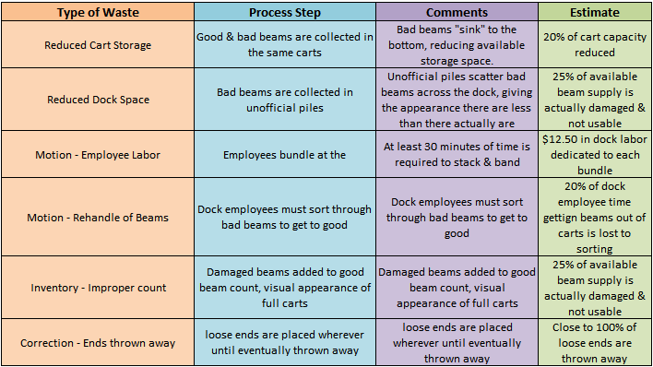
Build – Research potential causes by performing root cause analysis
Multi voting by the NAS team determined a dedicated, single, consolidation cart would be the most efficient way to handle the movement of damaged beams
Through brainstorming and a waste walk, the NAS team decided the cart should have dock a sign, be placed in a centralized location, and promote use even with no education

Slide 7
Current Process
Proposed Process
Damaged beams arrive in break trailers and in bulk shipments
Damaged beams arrive in break trailers and in bulk shipments
All beams are placed into board/beam decking carts
Beams are placed into carts and into piles on the dock floor
All damaged beams are placed in the bad beam cart
All loose ends are placed in the loose ends barrel
Damaged beams remain in carts, taking up valuable space
Damaged beams remain on the dock, taking up valuable bay space
When the cart is full, the bundle is banded and billed immediately
When the barrel is full, the barrel is billed and shipped to a repair facility
When a threshold is reached, dock labor is used to stack and bundle
The repair facility returns the empty barrel as instructed
Loose ends are placed wherever or thrown away
Bundle is moved, unbilled, to a repair facility

Slide 8
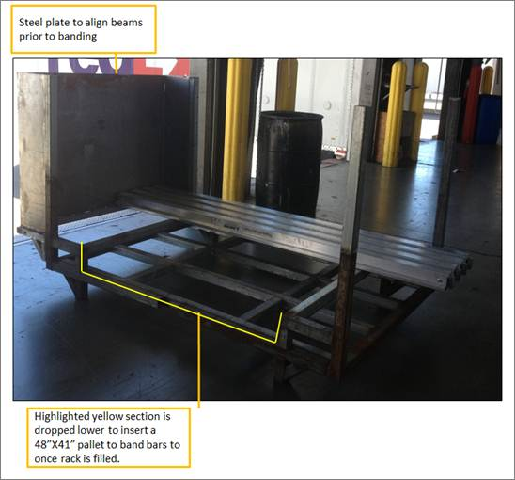
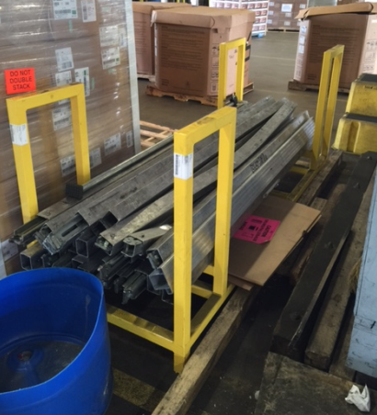
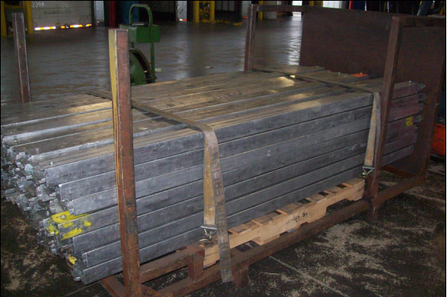
Build – Bundling Cart Design
Current bundling cart designs
No policy written for usage
No standard design
Carts designed to move mass quantities of good beams, not bad

Slide 9
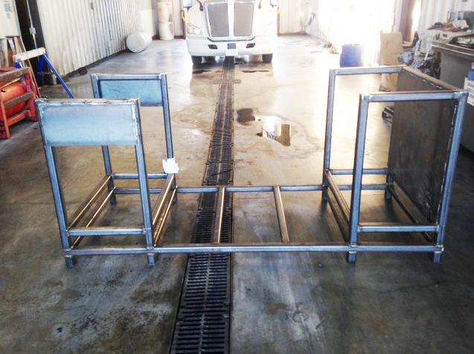
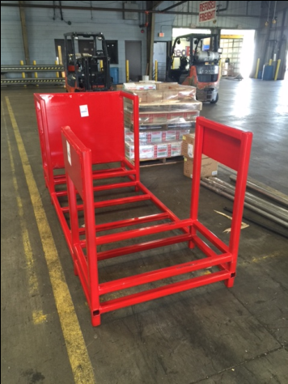
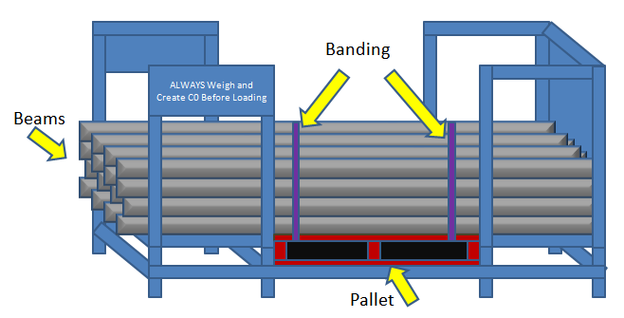
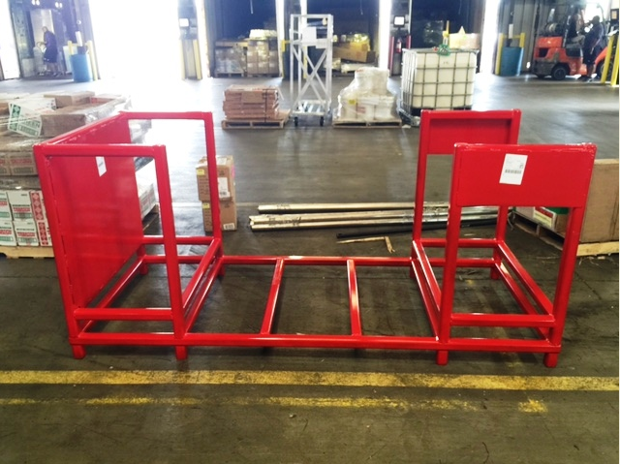
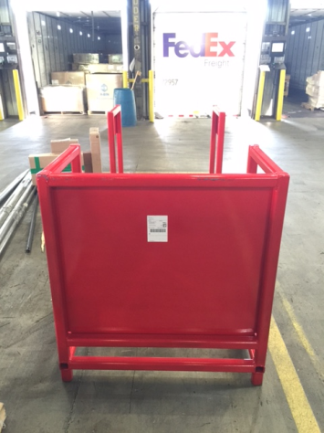
Build – Proposed + Actual Bundling Cart Design

Slide 10
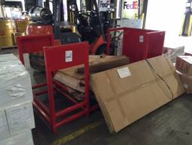
Launch – Introduction of the Bundling Cart
The tool by itself did not promote intuitive use
A process needed to be developed to create the desired result
The NAS team determined the following policy:
The cart is to be placed in a centralized location where the main pre-shifts are held on the dock and not moved
Damaged beams are to be immediately loaded into the cart and not placed in piles or in other carts, thus removing the need to use productive hours to build
Once full, the beams are to be banded twice around the bundle and twice to the pallet.
Bundles are billed immediately to repair locations with the keyword “BROK”
Loose ends are collected in a barrel, which will also be sent to repair locations. Repair locations will empty and send the barrel back.
EOL locations will send damaged beams to the hub daily, where they will be bundled.
All Supervision are responsible for monitoring

Slide 11
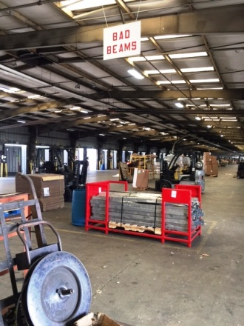
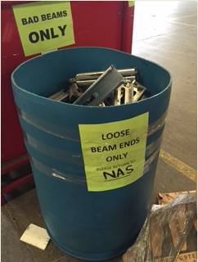
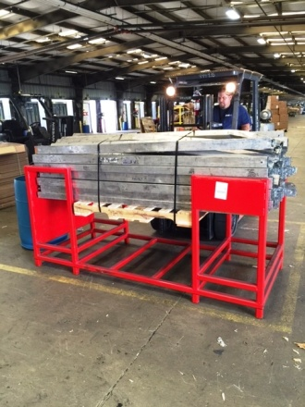
Launch – Introduction of the Bundling Cart
Dock Placement
Loose Ends
Bundle Removal

Slide 12
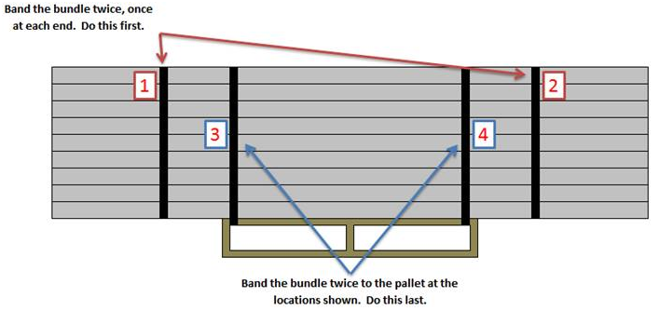
BUILD – New Banding Process
New bundles were not staying together as planned
The team went briefly back to the BUILD phase of ABLE to re-engineer the optimal banding sequence

Slide 13
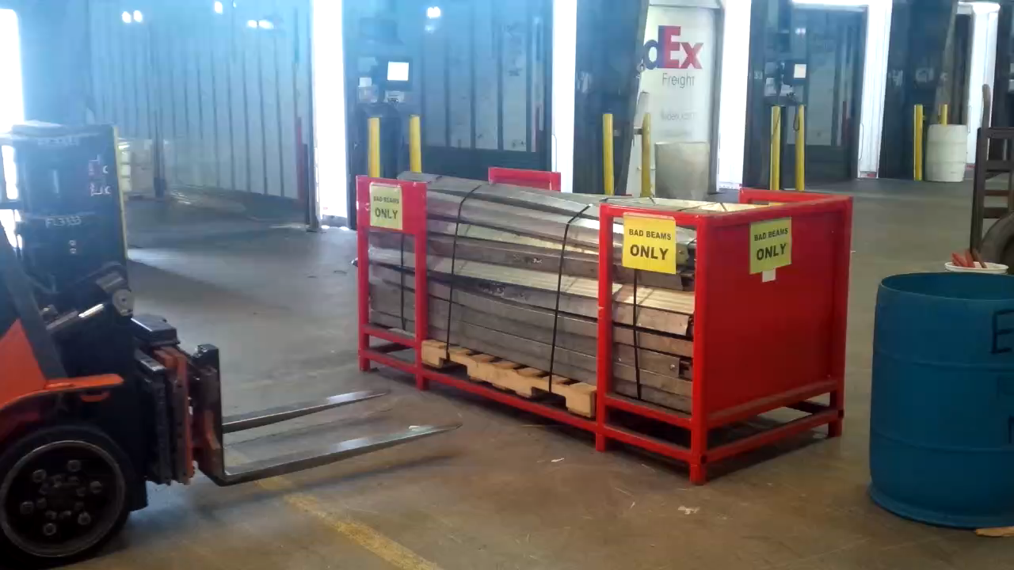
Launch – Removing Banded Bundles

Slide 14
Launch – Finalized Process
Final Process for Damaged Beam + Loose End Consolidation & Movement:
Consolidation cart & end collection barrel are placed in a centralized location at a HUB
“Bad Beams” sign hung above the consolidation cart
1 empty pallet is loaded into the bottom of the cart
Employees load bad beams and loose ends into the receptacles as they work
When the cart is full it contains approximately 90-95 beams
The bundle is to be banded twice through the pallet & around the bundle, as well as twice around just the bundle
The bundle is to be billed as a C0 bill to a repair location with the keyword, “BROK”
When the barrel is full, it contains approximately 120 loose ends
The barrel is to be billed as a C0 bill to a repair location with the keyword “BROK”
Instructions on the barrel state to return to the shipping location
EOL centers load damaged beams & loose ends back to HUBs daily

Slide 15
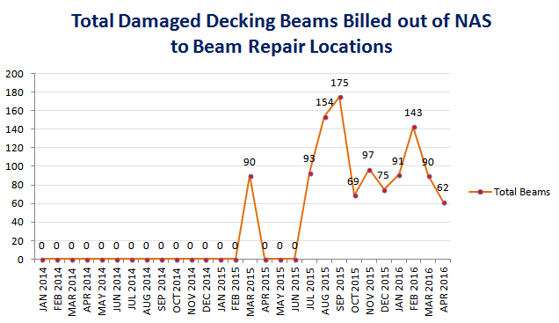
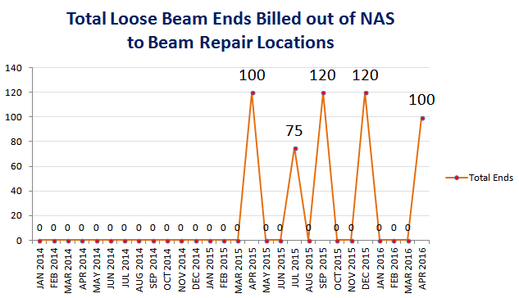

Evaluate - NAS
1,139 damaged decking beams returned to repair facilities @ 24,925 pounds
11 bundles assembled
Approximate time savings = 220 hours vs. manual bundling
$5,500 saved in dock labor just with the bundling
$45,788 to replace damaged beams with new
Zero bundles billed JAN ‘14 – JAN ‘15
535 damaged beam ends returned to repair facilities @ 2,270 pounds
5 full barrels sent & empties returned
$3,771.75 in savings if all ends replaced with new
Zero ends billed JAN ‘14 – JAN ‘15

Slide 16
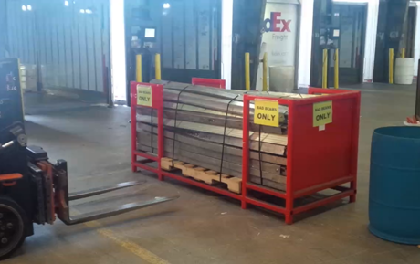
Damaged Beam & Loose Beam End Management QAT Update (1/2)
Launched in NAS
Created a tool for collecting & consolidating decking beams, with a 10 minute bundling process
Created a tool for collecting & shipping loose beam ends to repair locations
Next step is to supply additional centers with green carts for good, red for bad

Slide 17
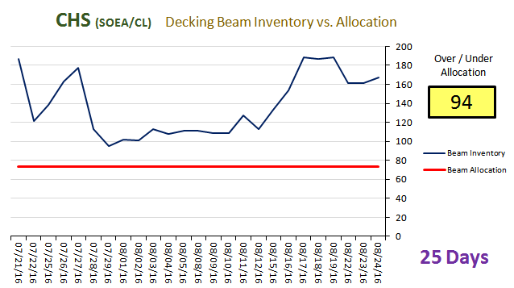
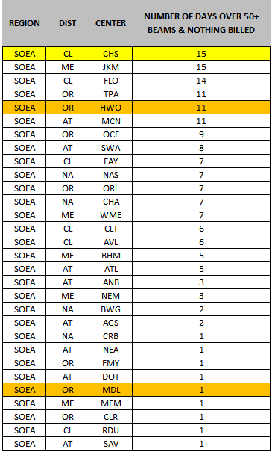
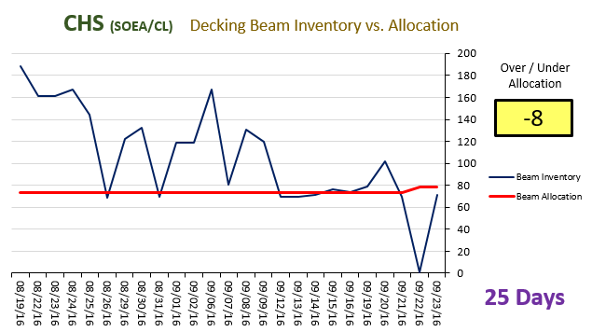
Damaged Beam & Loose Beam End Management QAT Update
BEFORE CART
The cart process was launched in CHS to see if the same concept would work with excess beam movement
AFTER CART

Slide 18
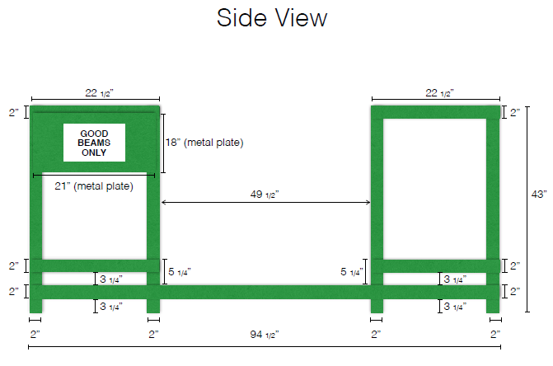
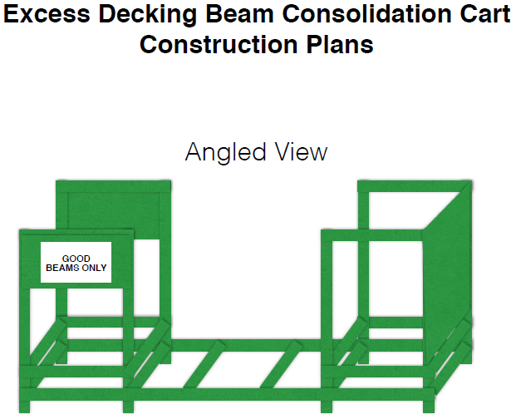
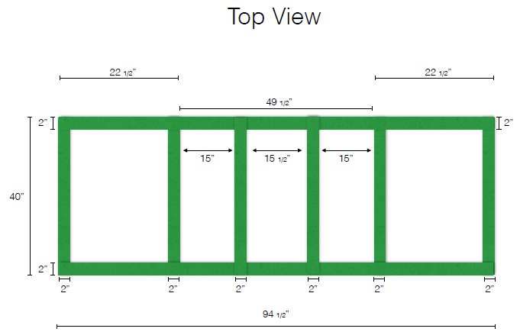
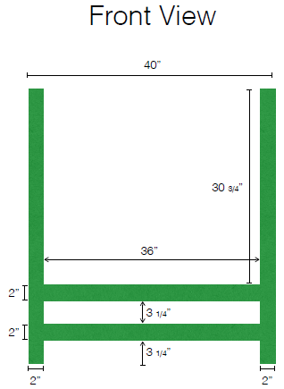
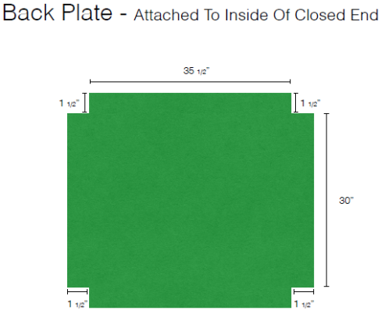
Expanding Further…
Cart design formalized
Green racks for excess
Red rack for damaged
Ordering of all supplies set up in ePro
eProcurement Vendor Item Descriptions
Excess Good Beam Rack (59682) $695.00 EACH
GOOD BEAM RACK – EXCESS DECKING BEAM CONSOLIDATION CART 94 1
BEARDS WELDING
Damaged Beam Rack (59683) $695.00 EACH
BAD BEAM RACK – DAMAGED DECKING BEAM CONSOLIDATION CART 94 1
BEARDS WELDING
Bad Beams Sign Kit (59696) $70.00 EACH
SIGN, BAD BEAMS 36X24 RED AND WHITE VINYL (4) S-HOOKS, 36”
IBISTEK SIGNS & ACCESSORIES
55 Gallon Drum Get From Shop Locations
Loose Ends Sign for Drums Print Locally

Slide 19
Rollout Process & Progress
Based off historical decking beam data, locations were chosen to be able to purchase their own tools and start the process
Due to construction limitations, the rollout consists of 3 different waves:
WAVE 1 – Excess GREEN + Damaged RED Decking Beam Rack Rollout Schedule:
01/20/17 – Initial data supplied to rollout centers (20 GREEN locations / 8 RED locations)
01/25/17 – Conference call scheduled with SCM, SACP, & MGR-Service Assurance
*Locations can begin ordering immediately after the call
WAVE 2 - Excess GREEN + Damaged RED Decking Beam Rack Rollout Schedule:
02/17/17 - Initial data supplied to rollout centers (21 GREEN locations / 10 RED locations)
02/22/17 - Conference call scheduled with SCM, SACP, & MGR-Service Assurance
*Locations can begin ordering immediately after the call
WAVE 2 - Excess GREEN + Damaged RED Decking Beam Rack Rollout Schedule:
03/17/17 - Initial data supplied to rollout centers (2 GREEN locations / 18 RED locations)
03/22/17 - Conference call scheduled with SCM, SACP, & MGR-Service Assurance
*Locations can begin ordering immediately after the call

